Slide 1
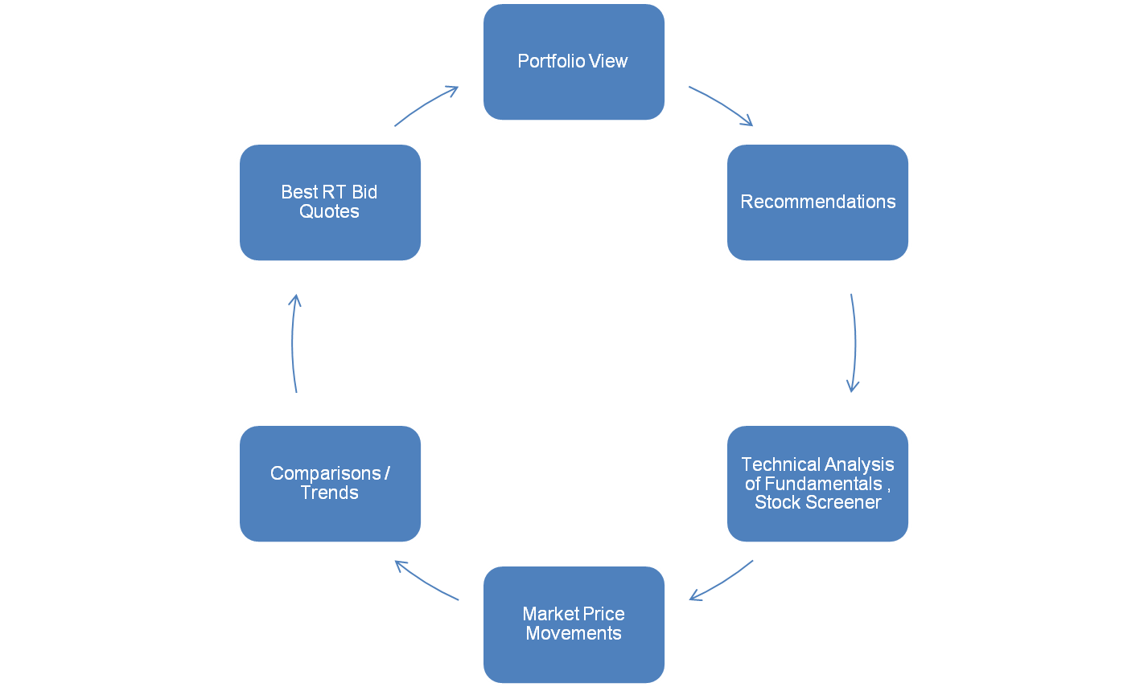

iOMS SaaS - Market Analytics

Slide 2

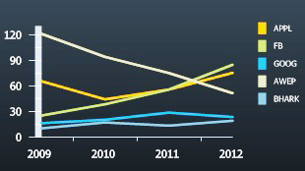
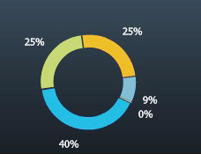
Portfolio View
Net Worth
$406,295 +1,922 (+0.48%)
Max Gainer
APPL (73.75) 27.16% (0.25%)
Max Looser
GOOG (67.10) -35,344 (-6.70%)
Scrip | Live Price | Change | Qty | Inv. Price | Day's Gain | Day's Gain% | Overall Gain | Overall Gain% | Latest Value
APPL | 73.75 | -0.05 | 100 | 58.00 | -5 | -0.07% | 1,575 | 27.16% | 7,375
FB | 84.00 | +1.35 | 100 | 74.00 | 135 | 1.63% | 1,000 | 13.51% | 8,400
GOOG | 67.10 | +2.95 | 160 | 288.00 | 472 | 4.60% | -35,344 | -6.70% | 10,736
AWEP | 1634.05 | +25.00 | 1 | 1,630.00 | 25 | 1.55% | 4 | 0.25% | 1,634
BHARK | 112.40 | -2.20 | 35 | 100.00 | -77 | -1.92% | 434 | 12.40% | 3,934

Slide 3
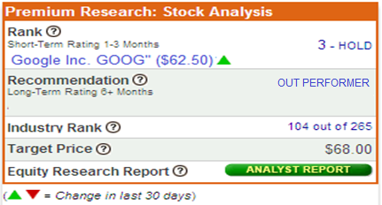
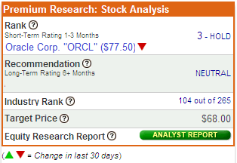
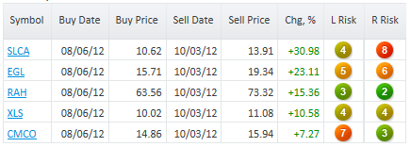
Recommendations
Portfolio View
Recommendations
Stock Screener
Price Movements
Comparisons
Best Bids
BULL OF THE DAY
BEAR OF THE DAY
TOP 5 RECOMMENDATIONS

Slide 4

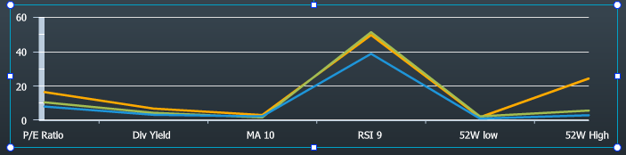






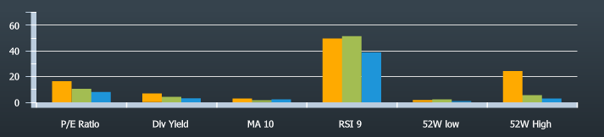

Stock Screener
Portfolio View
Recommendations
Stock Screener
Price Movements
Comparisons
Best Bids
SEHK
ALL Sectors
More Filters
Market Cap
800
1800
P/E Ratio
8
17
Div Yield
3
8
MA 10
1
3
RSI 9
30
55
52 W Low
0.5
3
52 W High
4
30
View Result
Stock | Name | Sector Name | Exchange | Market Cap | P/E Ratio | Div Yield | MA 10 | RSI 9 | 52W Low % | 52W High %
00097 | HENDERSON INVESTMENT LIMITED | Consolidated Enterprises | SEHK | 1729.2 M | 16.373 | 6.78 % | 2.97 % | 49.668 | 1.72 % | 24.2 %
00177 | JIANGSU EXPRESSWAY CO. LTD | Ports / Logistics & Transportation | SEHK | 819.4 M | 10.456 | 4.25 % | 1.56 % | 51.456 | 2.23 % | 5.57 %
00190 | HKC (HOLDINGS) LIMITED | Construction | SEHK | 1298 M | 8.002 | 3.12 % | 2.24 % | 38.768 | 0.9 % | 2.89 %

Slide 5



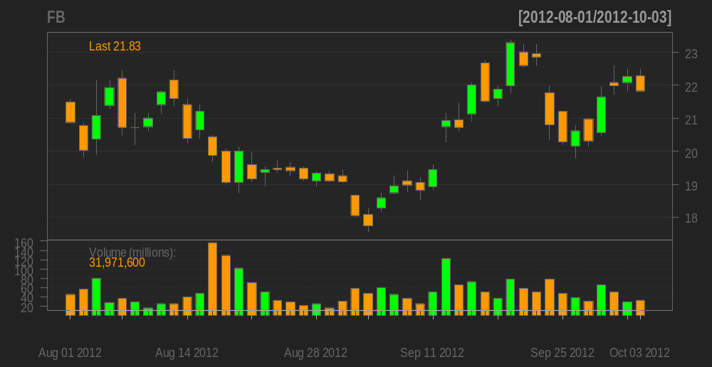











Market Price Movements
Portfolio View
Recommendations
Fundamentals
Price Movements
Comparisons
Best Bids
FaceBook “FB”
Last 3 Months
Top Gainers
Last 3 Months
BUY
SELL
Symbol | % Chg | Volume
AAPL | 4.8 | 512,100
GOOG | 3.5 | 812,700
FB | 2.5 | 455,020
AWEB | 1.6 | 312,021
BHRK | 0.8 | 120,511
Top Losers
Symbol | % Chg | Volume
MSFT | 3.6 | 512,100
ORCL | 2.1 | 812,700
SONY | 1.4 | 455,020
AADF | 0.9 | 312,021
CADR | 0.3 | 120,511
Plot Indicators:
DEMA
EMA
SMA
WMA
EWMA
MACD
ADX
ATR
ROC
RSI
WPR
CMF

Slide 6
Comparisons
Portfolio View
Recommendations
Stock Screener
Price Movements
Comparisons
Best Bids

Slide 7


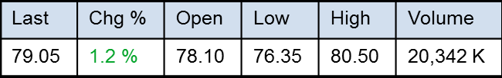
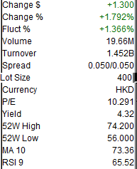
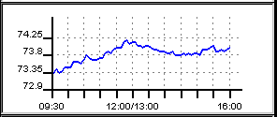
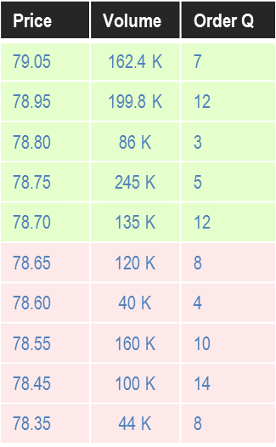
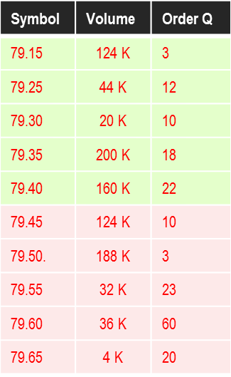
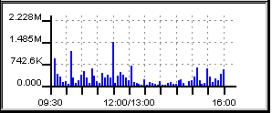
Best Bids
Portfolio View
Stock Screener
Price Movements
Comparisons
Best Bids
Portfolio View
Portfolio View
Recommendations
Portfolio View
Recommendations
Stock Screener
Recommendations
00005
BUY
SELL
HSBC HOLDINGS
Fundamentals
Intra-Day (Price)
BID (79.05)
SELL (79.15)
Intra-Day (Volume)

Slide 8
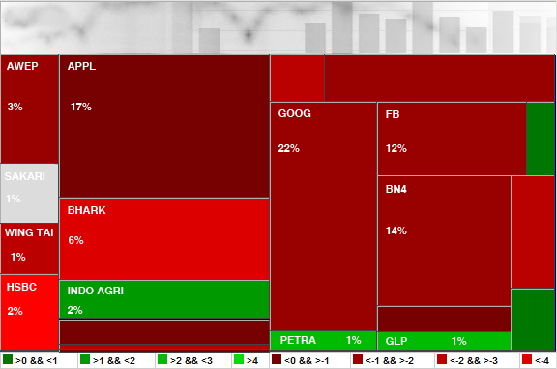
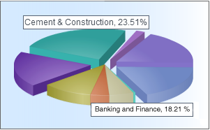
Risk Management
RISK PROFILE
TRANSACTION LIMIT
200,000.00
CHANNEL LIMIT
500,000.00
SPREAD LIMIT
30
STOP LOSS LIMIT
1.5%
CREDIT CHECKING
ORDER CHECKING
MARGIN TRADE LIMIT
500,000.00
SHORT SELL
FILL OR KILL
EXPOSURE LIMIT
850,000.00
SHORT SELL < = LAST
CURRENCY TRADE
LOAN LIMIT
200,000.00
EXCHANGE TRADE
STOP LOSS ORDER
INTRADAY LIMIT
350,000.00
GOOD TILL CANCELLED
ODD LOT ORDER

